Slide 1





9 – 12 OCTOBER 2024 | LISBON, PORTUGAL
@EACTS
#EACTS2024 #EACTS
www.eacts.org

Slide 2

European International Fairs Ltd
Freight Forwarder & On-site Handling Contractor
THE 38TH EACTS ANNUAL MEETING | 9 – 12 OCTOBER 2024

Slide 3
Services
Sea, air and road freight
Express/dedicated road freight & courier shipping
Customs clearance, export and import clearances, TIB, ATA Carnet, IC
Advance warehouse facility in Lisbon
On-site co-ordination, truck scheduling & management
Off loading, delivery to booth
Empty case storage
On-site lifting and labour for unpacking/positioning etc.
Re-export services
3 | THE 38TH EACTS ANNUAL MEETING | 9 – 12 OCTOBER 2024 | LISBON, PORTUGAL

Slide 4
Ordering Services
We offer a very easy to use on-line ordering system.
Service Order Form
This system is new that allows:
Creating an account
Ordering on-line, updating and changing the order
View of previous orders regardless of event and or location
Secure process – tailored services to meet your requirements
4 | THE 38TH EACTS ANNUAL MEETING | 9 – 12 OCTOBER 2024 | LISBON, PORTUGAL

Slide 5
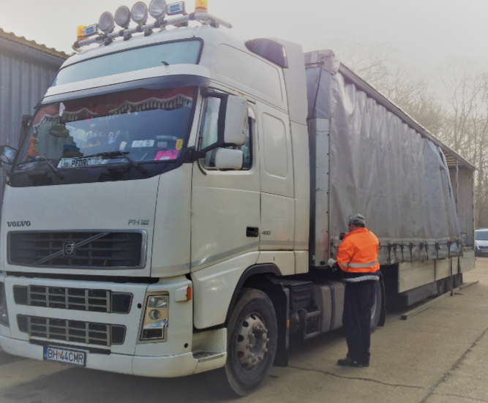


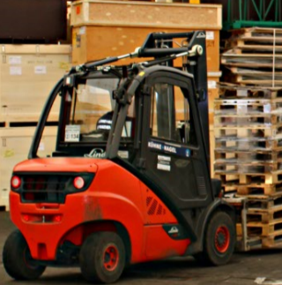
RAISING STANDARDS THROUGH EDUCATION AND TRAINING
www.eacts.org

Slide 6

THANK YOU
@EACTS
#EACTS2024 #EACTS
www.eacts.org

